Slide 1
THE THEORY OF PRODUCTION
Professor Ravi Kiran

Slide 2
Production
Production involves transformation of inputs such as capital, equipment, labor and land into output - goods and services
In this production process, the manager is concerned with efficiency in the use of the inputs
- technical vs. economical efficiency
The objective of efficiency will provide us with some basic rules about the manner in which firms should utilize inputs to produce goods and services

Slide 3
Technical vs. Economical efficiency
Economic efficiency:
  occurs when the cost of producing a given output is as low as possible
Technical efficiency:
  occurs when it is not possible to increase output without increasing inputs

Slide 4
Theory of Production
The basic production theory is simply an application of the constrained optimization:
  The firm attempts either to minimize the cost of producing a given level of output
  Or
  to maximize the output attainable with a given level of cost.

Slide 5
Production Function
A production function shows the maximum amount of output that can be produced from any specified set of inputs, given the existing technology
Q
Q = output
x = inputs
X

Slide 6
Production Function
Q = f(X1, X2,…, Xk)
  where
  Q = output
  X1,…,Xk = inputs
For economic analysis, let’s reduce the inputs to two, capital (K) and labor (L):
Q = f(L, K)

Slide 7
Short-Run Production
In the short run some inputs are fixed and some variable
  e.g. the firm may be able to vary the amount of labor, but cannot change capital
  in the short run we can talk about factor productivity

Slide 8
Relationship Between Total, Average, and Marginal Product: Short-Run Analysis
Total Product (TP) = total quantity of output
Average Product (AP) = total product/total input
Marginal Product (MP) = change in quantity when one additional unit of input used

Slide 9
The Marginal Product of Labor
The marginal product of labor is the increase in output obtained by adding 1 unit of labor but holding constant the inputs of all other factors
Marginal Product of L:
MPL = ΔQ/ΔL (holding K constant)
= δQ/δL
Average Product of L:
APL = Q/L (holding K constant)

Slide 10
Law of Diminishing Returns
(Diminishing Marginal Product)
Holding all factors constant except one, the law of diminishing returns says that:
beyond some value of the variable input, further increases in the variable input lead to steadily decreasing marginal product of that input
  e.g. trying to increase labor input without also increasing capital will bring diminishing returns

Slide 11
Law of Diminishing Returns
Sometimes referred to as variable factor proportions, law of diminishing returns states that as equal quantities of one variable factor are increased, while other factor inputs remain constant (ceteris paribus), a point is reached beyond which the addition of one more unit of the variable factor will result in a diminishing rate of return and the marginal product will fall.

Slide 12
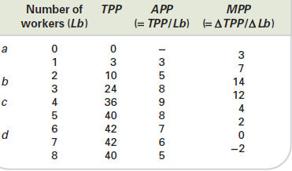

Slide 13
Law of Diminishing Returns
With nobody working on the land, output will be zero (point a).
As the first farm workers are taken on, wheat output initially rises more and more rapidly.
The assumption behind this is that with only one or two workers efficiency is low, since the workers are spread too thinly.
With more workers, however, they can work together – each, perhaps, doing some specialist job – and thus they can use the land more efficiently.
Output rises more and more rapidly up to the employment of the third worker (point b).
The TPP curve gets steeper up to point b.

Slide 14
Law of Diminishing Returns
After point b, however, diminishing marginal returns sets in: output rises less and less rapidly, and the TPP curve correspondingly becomes less steeply sloped.
When point d is reached, wheat output is at a maximum: the land is yielding as much as it can.
Any more workers employed after that are likely to get in each other’s way.
Thus beyond point d, output is likely to fall again: eight workers produce less than seven workers.

Slide 15
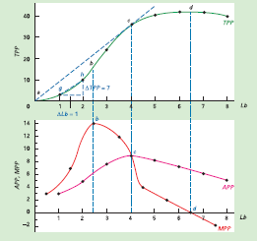

Slide 16
The short-run production function: average and marginal product
In addition to total physical product, two other important concepts are illustrated by a production function: namely,
average physical product (APP) and marginal physical product (MPP).

Slide 17
Average physical product of labour when four workers are employed is 36/4 = 9 tonnes per year.
Marginal physical product
This is the extra output (ΔTPP) produced by employing one more unit of the variable factor.
Thus the marginal physical product of the fourth worker is 12 tonnes.
The reason is that by employing the fourth worker, wheat output has risen from 24 tonnes to 36 tonnes: a rise of 12 tonnes.
In symbols, marginal physical product is given by:
MPP = ΔTPP/ΔQv
Thus in our example:
MPP = 12/1 = 12

Slide 18
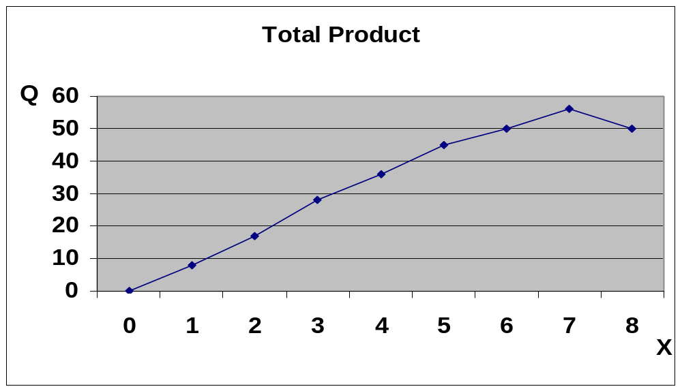

Slide 19
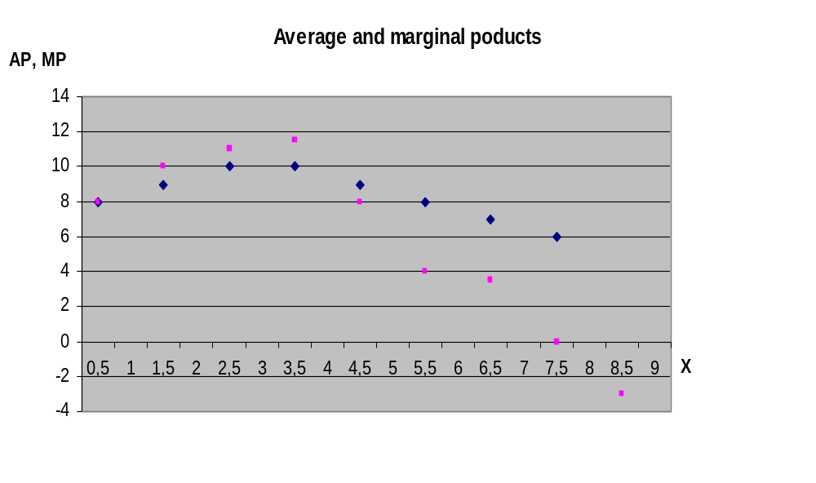
Average and Marginal Products

Slide 20
Three Stages of Production
AP,MP
Stage I
Stage II
Stage III
AP_{X}
MP_{X}
X
Fixed input grossly underutilized; specialization and teamwork cause AP to increase when additional X is used
Specialization and teamwork continue to result in greater output when additional X is used; fixed input being properly utilized
Fixed input capacity is reached; additional X causes output to fall

Slide 21
Three stages
TOTAL PRODUCT | MARGINAL PRODUCT | AVERAGE PRODUCT
STAGE I INCREASES AT AN INCREASING RATE | INCREASES, REACHES ITS MAXIMUM & THEN DECLINES TILL MP = AP | INCREASES & REACHES ITS MAXIMUM
STAGE II INCREASES AT A DIMINISHING RATE TILL IT REACHES MAXIMUM | IS DIMINISHING AND BECOMES EQUAL TO ZERO | STARTS DIMINISHING
STAGE III STARTS DECLINING | BECOMES NEGATIVE | CONTINUES TO DECLINE

Slide 22
Three stages
FROM THE ABOVE TABLE ONLY STAGE II IS RATIONAL WHICH MEANS RELEVANT RANGE FOR A RATIONAL FIRM TO OPERATE.
IN STAGE I IT IS PROFITABLE FOR THE FIRM TO KEEP ON INCREASING THE USE OF LABOUR.
IN STAGE III, MP IS NEGATIVE AND HENCE IT IS INADVISABLE TO USE ADDITIONAL LABOUR.

Slide 23
Long run production
In the long run all inputs become variable e.g. the long run is the period in which a firm can adjust all inputs to changed conditions in the long run we talk about returns to scale

Slide 24
Production in the Long-Run
All inputs are now considered to be variable (both L and K in our case)
How to determine the optimal combination of inputs?
To illustrate this case we will use production isoquants.
An isoquant is a curve showing all possible combinations of inputs physically capable of producing a given fixed level of output.
AN ISOQUANT OR ISO PRODUCT CURVE OR EQUAL PRODUCT CURVE

Slide 25
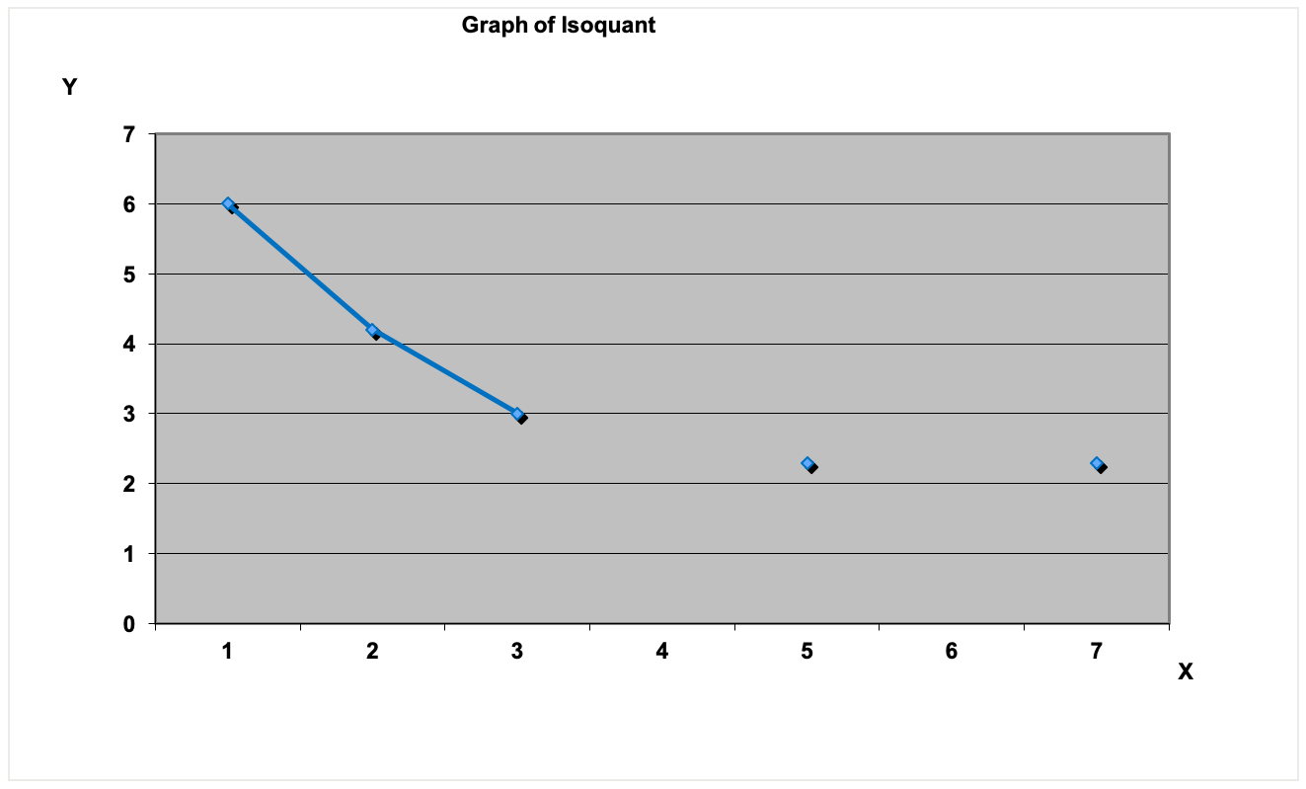
An Isoquant

Slide 26
IMPORTANT ASSUMPTIONS
The two inputs can be substituted for each other. For example if labour is reduced in a company it would have to be compensated by additional machinery to get the same output.

Slide 27
Types of Isoquant
Linear Iso-quant
Right-angle Iso-quant
Convex Iso-quant

Slide 28
LINEAR ISOQUANTS
In linear isoquants there is perfect substiutabilty of inputs.
For example in a power plant equipped to burn oil or gas. Various amounts of electricity could be produced by burning gas, oil or a combination. OIL AND GAS ARE PERFECT SUBSITUTES. Hence the isoquant would be a straight line.

Slide 29
Substituting Inputs
From above we can see that there exists some degree of substitutability between inputs.
Different degrees of substitution:
K
K
Capital
K₁ K₂ K₃ K₄
Q
Q
L
L₁ L₂ L₃ L₄
L
a) Perfect substitution
b) Perfect Complementarity
All other ingredients

Slide 30
Right-angle isoquants
In right-angle isoquants there is complete non-substiutabilty between inputs.
For example two wheels and a frame are required to produce a bycycle these cannot be interchanged.
This is also known as leontief isoquant or input-output isoquant.

Slide 31
Convex Isoquants
In convex isoquants there is substiutabilty between inputs but it is not perfect.
For example
(1) a shirt can be made with large amount of labour and a small amount machinery.
(2) the same shirt can be with less labourers, by increasing machinery.
(3) the same shirt can be made with still less labourers but with a larger increase in machinery.

Slide 32
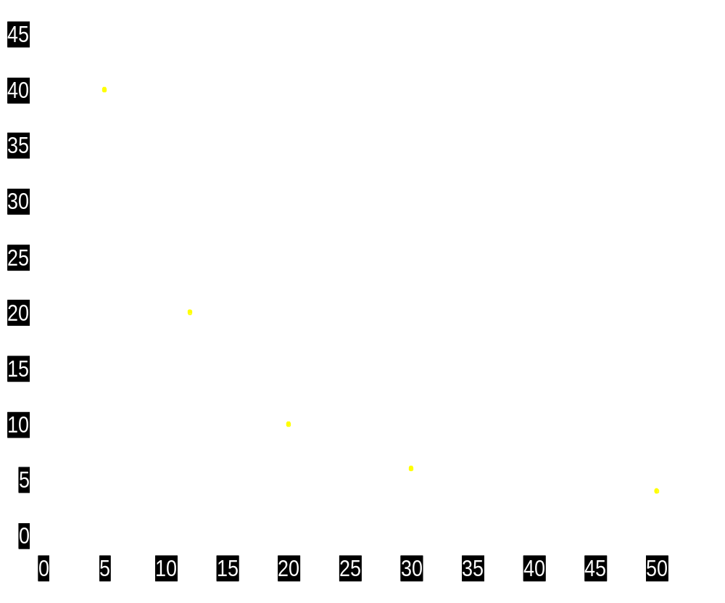

An isoquant yielding output (TPP) of 5000 units
a
Units
of K
40
20
10
6
4
Units
of L
5
12
20
30
50
Point on
diagram
a
b
c
d
e
Units of capital (K)
Units of labour (L)

Slide 33
An isoquant yielding output (TPP) of 5000 units
a
Units
of K
40
20
10
6
4
Units
of L
5
12
20
30
50
Point on
diagram
a
b
c
d
e
Units of capital (K)
b
Units of labour (L)

Slide 34
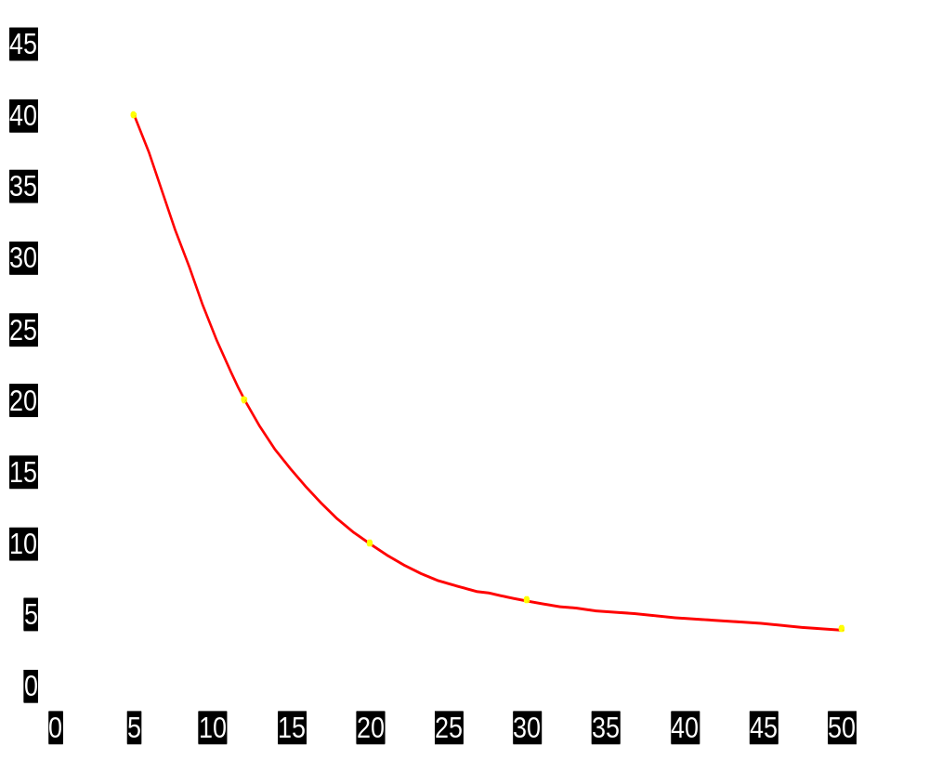
An isoquant yielding output (TPP) of 5000 units
a
Units
of K
40
20
10
6
4
Units
of L
5
12
20
30
50
Point on
diagram
a
b
c
d
e
Units of capital (K)
b
c
d
e
Units of labour (L)

Slide 35
Properties of Isoquants
An isoquant is downward sloping to the right. I.E NEGATIVELY INCLINED. This implies that for the same level of output, the quantity of one variable will have to be reduced in order to increase the quantity of other variable.
A higher isoquant represents larger output. That is with the same quantity of one input and larger quantity of the other input, larger output will be produced.

Slide 36
Properties of Isoquants
No two isoquants intersect or touch each other. If the two isoquants do touch or intersect that means that a same amount of two inputs can produce two different levels of output which is absurd.
Isoquant is convex to the origin. This means that the slope declines from left to right along the curve. That is when we go on increasing the quantity of one input say labour by reducing the quantity of other input say capital, we see less units of capital are sacrificed for the additional units of labour.

Slide 37
ISOQUANT- ISOCOST ANALYSIS
Isoquants
  their shape
  diminishing marginal rate of (technical) substitution
  Rate at which we can substitute capital for labour and still maintain output at the given level.
MRTS = ΔK / ΔL
Sometimes just called Marginal rate of Substitution (MRS)

Slide 38
Diminishing marginal rate of tech. substitution
g
MRTS = -2
MRTS = ΔK / ΔL
ΔK = -2
h
ΔL = 1
Units of capital (K)
isoquant
Units of labour (L)

Slide 39
Diminishing marginal rate of factor substitution
g
MRTS = -2
MRTS = ΔK / ΔL
ΔK = -2
h
ΔL = 1
Units of capital (K)
j
MRTS = -1
ΔK = -1
k
ΔL = 1
isoquant
Units of labour (L)

Slide 40

An isoquant map
Units of capital (K)
Q₁=5000
Units of labour (L)

Slide 41
Substituting Inputs
In case the two inputs are imperfectly substitutable, the optimal combination of inputs depends on the degree of substitutability and on the relative prices of the inputs

Slide 42
Substituting Inputs continued
MRTS = ΔL/ΔK
MRTS is when some of L is removed from the production and substituted by K to maintain the same level of output

Slide 43
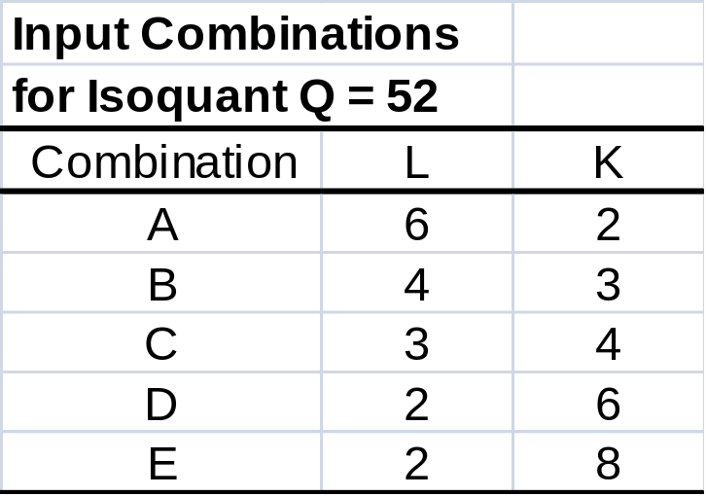
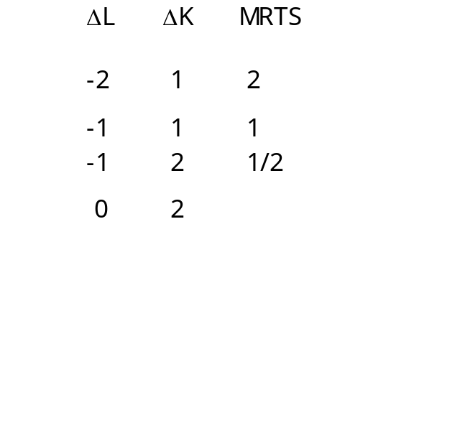
Diminishing Marginal Rate of Technical Substitution:

Slide 44
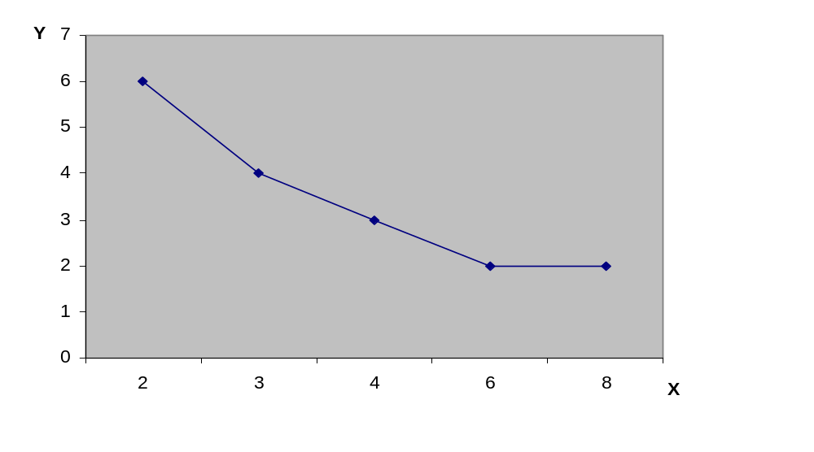
Diminishing Marginal Rate of Technical Substitution continued
A
ΔY =- 2
B
C
ΔX = 1
ΔY = -1
D
E
ΔX = 1
ΔY = -1
ΔX = 2

Slide 45
Returns to Scale
Let us now consider the effect of proportional increase in all inputs on the level of output produced
To explain how much the output will increase we will use the concept of returns to scale

Slide 46
Increasing returns to scale
we are experiencing increasing returns to scale
Also constant returns to scale and decreasing returns to scale are possible

Slide 47
Reasons for Increasing or Decreasing Returns to Scale:
Often we can assume that firms experience constant returns to scale:
  for example doubling the size of a factory along with a doubling of workforce and machinery should lead to a doubling of output
  why could a greater (or smaller) than proportional increase occur?

Slide 48
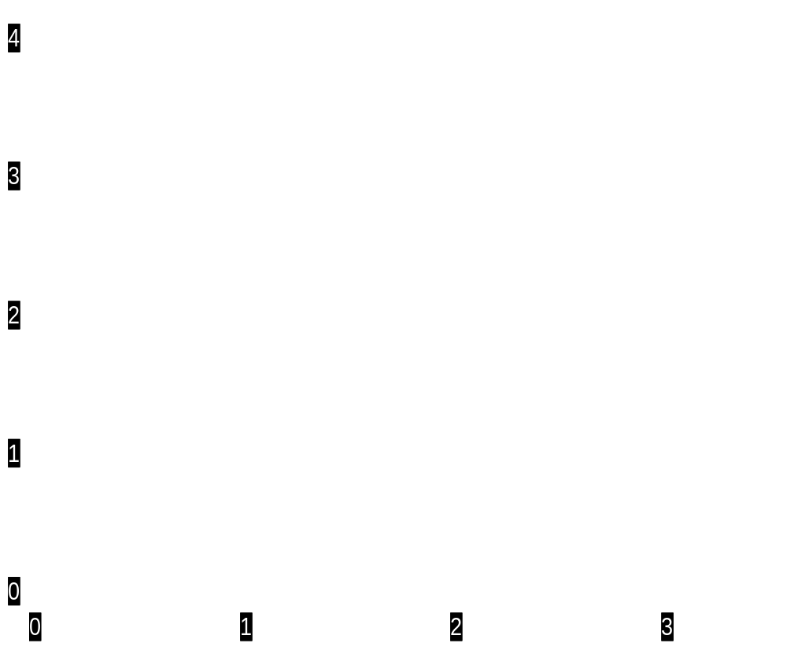
Increasing Returns to Scale (beyond point b)
R
c
700
600
Units of capital (K)
b
500
400
a
300
200
Units of labor (L)

Slide 49
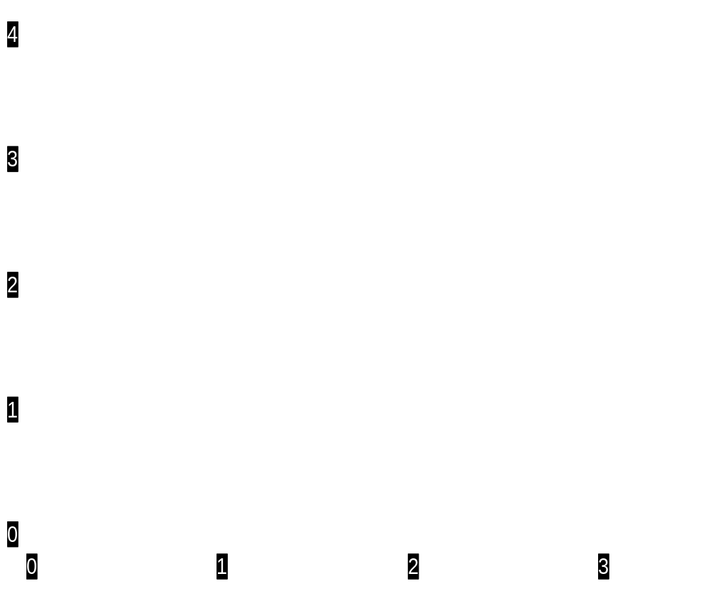
Constant Returns to Scale
R
c
600
Units of capital (K)
b
500
400
a
300
200
Units of Labour

Slide 50
Decreasing Returns to Scale (beyond point b)
R
c
500
Units of capital (K)
b
400
a
300
200
Units of labor (L)

Slide 51
Measurement of Returns to Scale continued
  Multiplying the coefficients of the production function:
  If original production function is
  Q = f(X,Y)
  and if the resulting equation after the multiplication of inputs by k is
hQ = f(kX, kY)
  where h presents the magnitude of increase in production

Slide 52
Then, if
h>k, increasing returns
h=k, constant returns
h<k, decreasing returns

Slide 53
Question?
For each of the following functions determine whether return to scale are decreasing or increasing or constant?
(a) Q=K/L
(b) Q=100+3K+2L
(c) Q=5kªL^{b} where a=0.6, b=.4
(d) Q=5kªL^{b} where a=0.8, b=.05
(e) Q=2k+3L+KL

Slide 54
1 This is a constant returns to scale since K/L will be a constant when both K and L are increased by the same proportion that is when inputs are doubled. Output still remains the same.
2 Q=100+3K+2L
When K = 1 and L = 1
Q=100+3+2=105
When K = 2and L = 2
Q=100+6+4=110
Therefore this production function plan describes decreasing returns to scale the output increase by less than the proportion by which the inputs are increased.
3. Q=5kªL^{b} where a=0.6, b=.4
Constant RTS a+b=1
4. The production function Q = 20 K ^{0.6} L ^{0.05} signifies
α = 0.6, β = 0.5, α + β = 0.6 + 0.5 = 1.1.
Therefore, this production function describes diminishing returns to scale since α + β < 1.
The production function Q = 2K + 3 L + KL signifies
When K = 1 and L = 1
Q = 2 + 3 + 1 = 6
When K = 2 and L = 2
Q = (2 x 2) + (3 x 2) + (2 x 2)
= 4 + 6 + 4 = 14
That is when inputs are doubled the output more than double. Hence the production function describes increasing returns to scale.

Slide 55
An isoquant map
Units of capital (K)
Q₁=5000
Units of labour (L)

Slide 56
An isoquant map
Units of capital (K)
Q₂=7000
Q₁
Units of labour (L)

Slide 57
An isoquant map
Units of capital (K)
Q₃
Q₂
Q₁
Units of labour (L)

Slide 58

An isoquant map
Units of capital (K)
Q₄
Q₃
Q₂
Q₁
Units of labour (L)

Slide 59
An isoquant map
Units of capital (K)
Q₅
Q₄
Q₃
Q₂
Q₁
Units of labour (L)

Slide 60
ISOQUANT- ISOCOST ANALYSIS
Isoquants
E.g: Cobb-Douglas Production Function
Q=K^{1/2} L^{1/2}
We now turn to an important aspect of production, namely returns to scale.

Slide 61
Suppose producing 5000 units with 10 units of capital and 5 units of labour
What happens now if we double the amount of capital and labour?
Units of capital (K)
Q₁=5000
5
Units of labour (L)

Slide 62
Suppose producing 5000 units with 10 units of capital and 5 units of labour
What happens now if we double the amount of capital and labour?
Units of capital (K)
Q₁=5000
5
Units of labour (L)

Slide 63
What is the output level at this new isoquant?
Units of capital (K)
Q₁=5000
5
Units of labour (L)

Slide 64
Suppose 20 K and 10 L gives 10,000 units
then we say there are constant returns to scale
Units of capital (K)
Q₁=5000
5
Units of labour (L)

Slide 65
Constant Returns to Scale
If Q(K,L) =5000
Then Q(2K,2L)
= 2Q(K,L) =10,000
Units of capital (K)
Q₂=10,000
Q₁=5000
5
Units of labour (L)

Slide 66
Constant Returns to Scale
For example the Cobb-Douglas Production Function: Q(K,L)= K^{1/2} L^{1/2}
Q(2K,2L)= (2K)^{1/2}(2L)^{1/2}
=2 K^{1/2}L^{1/2} =2Q(K,L)
A function such that Q(aK,aL)=aQ(K,L) for all a>0 (or a=0), is said to be HOMOGENOUS OF DEGREE 1 (sometimes: LINEAR HOMOGENOUS)

Slide 67
Increasing returns to scale, IRS
If Q(K,L) =5000
and Q(2K,2L)=15,000
>2Q(K,L)=10000
Then there is IRS
Units of capital (K)
Q₂=15,000
Q₁=5000
5
Units of labour (L)

Slide 68
Increasing returns to scale:
“Isoquants get closer together”
Units of capital (K)
Q₂=15,000
Q₂=10,000
Q₁=5000
5
Units of labour (L)

Slide 69
Decreasing returns to scale, DRS
If Q(K,L) =5000
and
Q(2K,2L)=7,000
< 2Q(K,L)=10000
Units of capital (K)
Q₂=7,000
Q₁=5000
5
Units of labour (L)

Slide 70
Decreasing returns to scale: “Isoquants get further apart”
Q₂=10,000
Units of capital (K)
Q₂=7,000
Q₁=5000
5
Units of labour (L)

Slide 71
ISOQUANT- ISOCOST ANALYSIS
Isoquants
  isoquants and marginal returns:
  The Marginal Return measures the change in output when one variable is changed and the other is kept fixed.
  To see this, suppose we examine the CRS diagram again, this time with 3 isoquants,
  5000, 10,000, and 15,000

Slide 72
Q₃=15000
Units of capital (K)
Q₂=10,000
Q₁=5000
5
15
Units of labour (L)

Slide 73
Isocost Curves
Assume P_{L}=Rs100 and P_{K} =Rs200
Combination | labor | capital
A | 0 | 5
B | 2 | 4
C | 4 | 3
D | 6 | 2
E | 8 | 1

Slide 74
Optimal Levels of Inputs
The optimality conditions given in the previous slides ensure that a firm will be producing in the least costly way, regardless of the level of output
But how much output should the firm be producing?
Answer to this depends on the demand for the product (like in the one input case as well)

Slide 75
Isocost Curve and Optimal Combination of L and K
K
5
“Q52”
10
L
Isocost and Isoquant Curve for Inputs L and K

Slide 76
Expansion Path
The long-run situation:
both factors variable
Expansion path
Units of capital (K)
300
TC =
£60 000
TC =
£40 000
TC =
£20 000
200
100
O

Slide 77
Optimal Combination of Inputs
How to determine the optimal combination of inputs As was said this optimal combination depends on the relative prices of inputs and on the degree to which they can be substituted for one another
This relationship can be stated as follows:
MPL/MPK = PL/PK

Slide 78
Equation of an isocost
Suppose you have 2 inputs, capital K & labor L.
The price of a unit of capital is P_{K}.
The price of a unit of labor is P_{L}.
Let a particular outlay amount be R.
Then all combinations of K & L such that
P_{L}L+ P_{K}K = R
lie on the isocost curve associated with that outlay.
If we rewrite the equation as
K = R/P_{K} – (P_{L}/P_{K})L ,
we see that the slope of the isocost is – (P_{L}/P_{K}) & the vertical intercept is R/P_{K} .

Slide 79
Graph of an isocost
For example, suppose you’re interested in the outlay amount $10,000. Suppose also that Labor cost $10 per unit & capital cost $100 per unit.
Then the slope of the isocost is
– P_{L}/P_{K} = – 10/100 = – 0.1 .
The vertical intercept would be 10,000/100 = 100
& the horizontal intercept is 10,000/10 = 1,000.
K
R/P_{K}= 100
slope = – P_{L}/P_{K} = – 0.1
R/P_{L} = 1000
L

Slide 80
Maximizing output for a given cost level
At points A & B, we’re spending the outlay associated with this isocost, but we’re not producing as much as we can. We’re only making Q₁ units of output.
We can’t produce Q₃ or Q₄ with this outlay. Those output levels would cost more.
At point E, we’re producing the most for the money, where the isocost is tangent to an isoquant.
isoquants
K
A
isocost
E
Q₄
Q₃
Q₂
B
Q₁
L

Slide 81
At the tangency of the isocost & isoquant, the slopes of those curves are equal.
We found previously that
the slope of the isoquant is – MP_{L}/MP_{K} ,
& the slope of the isocost is – P_{L}/P_{K} .
So at the tangency, – MP_{L}/MP_{K} = – P_{L}/P_{K}
or, multiplying by -1, MP_{L}/MP_{K} = P_{L}/P_{K} .
This expression is equivalent to MP_{L}/P_{L} = MP_{K}/P_{K} .

Slide 82
MP_{L}/P_{L} = MP_{K}/P_{K}
This condition means that to get the most output for your money, you should employ inputs such that the marginal product per dollar is equal for all inputs.
(Notice the similarity to the utility maximization condition that the marginal utility per dollar is equal for all goods.)

Slide 83
Minimizing cost for a given output level
At points A & B, we’re producing the desired quantity, but we’re not using the cheapest combination of inputs, so we’re spending more than necessary.
We can’t produce the desired output level at cost level C₁. We need more money.
At point E, we’re producing the desired output at the lowest cost, where the isoquant is tangent to an isocost.
K
A
E
B
Q₁
isoquant
L
isocosts C₁ C₂ C₃

Slide 84
So whether we’re maximizing output for a given cost level, or minimizing cost for a given output level, the condition is the same:
MP_{L}/P_{L} = MP_{K}/P_{K}
The marginal product per dollar is equal for all inputs.

Slide 85
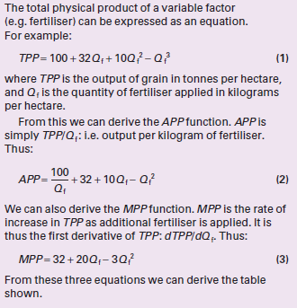

Slide 86
